Slide 1
ERD MODELLING
Inshall Javed (2022-BS-SE-114)
Ramisha Hafeez(2022-BS-SE-77)
Wajeeha Ashfaq(2022-BS-SE-104)
Rameen Aamir(2022-BS-SE-117)

Slide 2
INTRODUCTION
This project aims to develop a user-friendly GUI (Graphical User Interface) for Entity-Relationship Diagram (ERD) modeling, with a focus on automating and enhancing the process through text preprocessing. The main objective is to enable users to easily convert textual descriptions of database requirements into structured ER diagrams, which are essential for database design and data management.
The GUI interface allows users to interact intuitively with the ERD model, offering visual tools to create, modify, and analyze the relationships between different entities. Through this interactive interface, users can build detailed ERDs, making it an ideal tool for database designers, developers, and students learning about database modeling.

Slide 3
INTRODUCTION
A text preprocessor designed for Natural Language Processing (NLP) tasks that generates an Entity-Relationship (ER) diagram specifically for Requirement Engineering (RE) is a specialized tool that processes textual data to extract relevant information for modeling. It typically follows these steps:
Lowercase text
Remove Punctuation
Tokenization
Remove Stopwords
Lemmatization
Remove Digits
Bag of Words
POS Tagging
ER Diagram

Slide 4
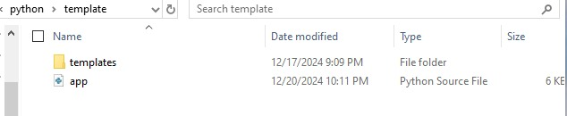
METHODOLOGY
1. Creating a folder named template and saving python file

Slide 5
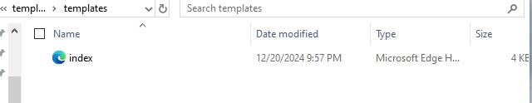
METHODOLOGY
2. Saving html code by creating template folder in the same location as app.py

Slide 6
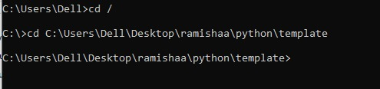
METHODOLOGY
3. Navigate to the directory containing python file

Slide 7
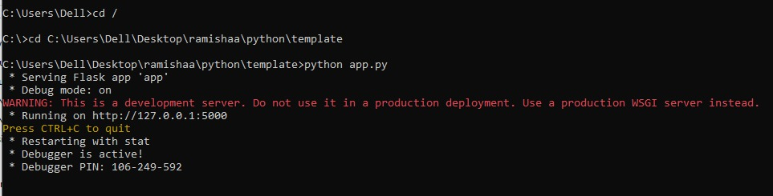
METHODOLOGY
4. Running python file

Slide 8
METHODOLOGY
5. Accessing the tool through browser

Slide 9
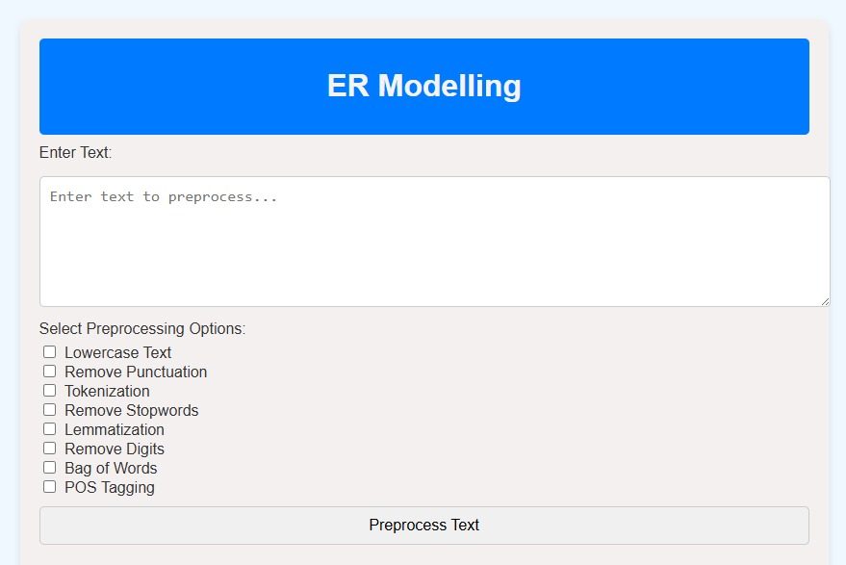
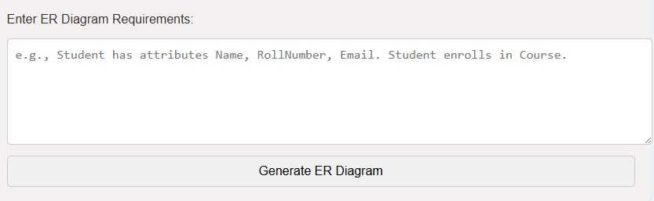
METHODOLOGY

Slide 10
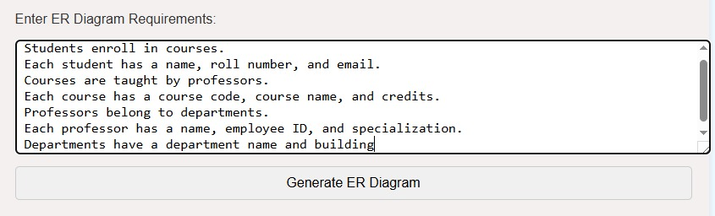
ENTITY RELATIOSHIP DIAGRAM

Slide 11
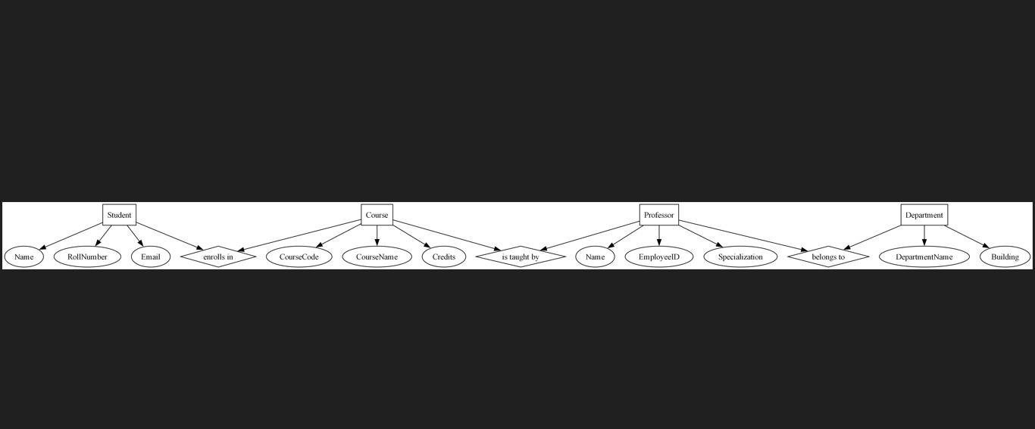
ENTITY RELATIOSHIP DIAGRAM

Slide 12
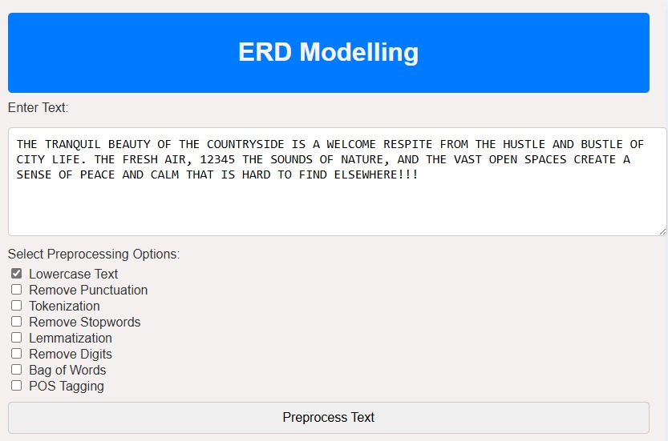
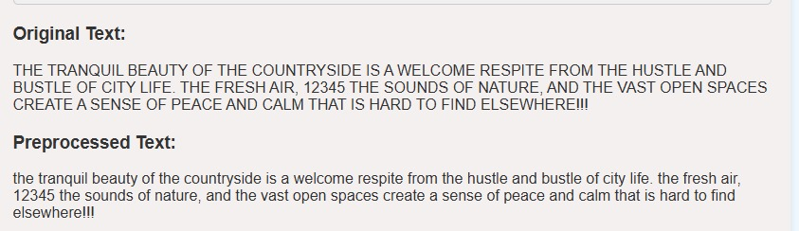
LOWER CASE

Slide 13
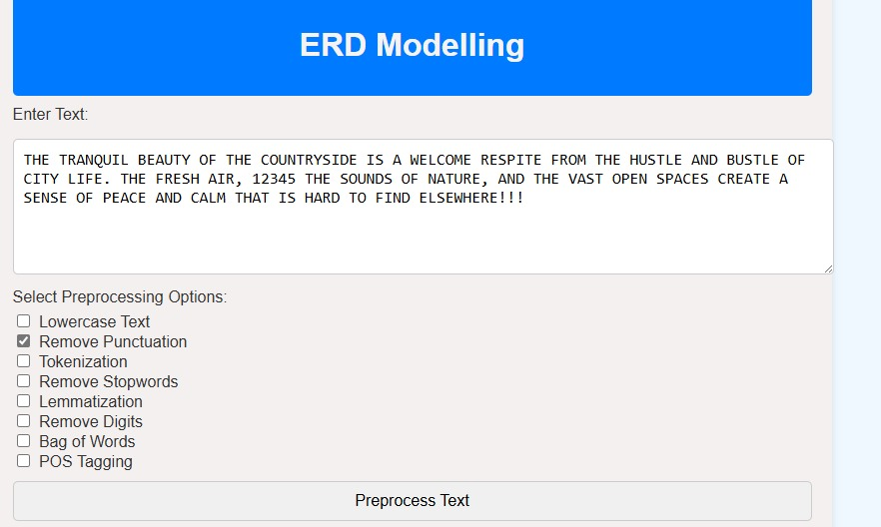
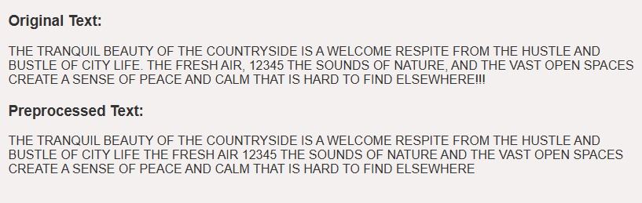
REMOVE PUNCTUATION

Slide 14
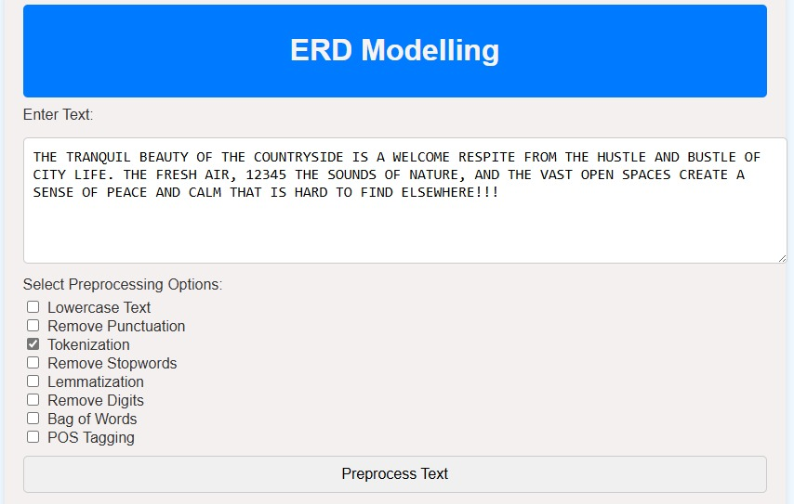
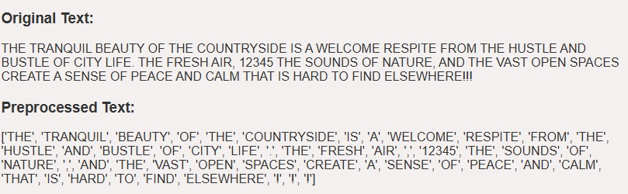
TOKENIZE

Slide 15
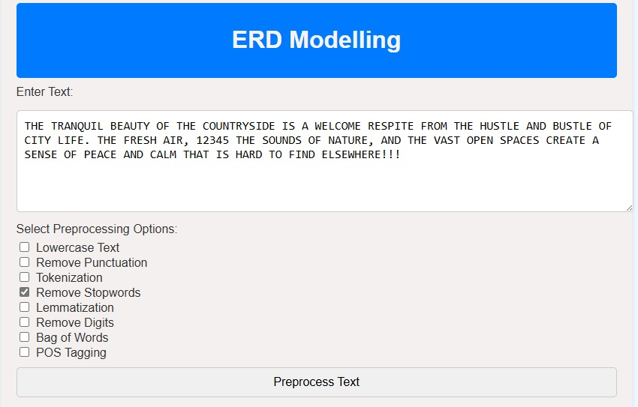
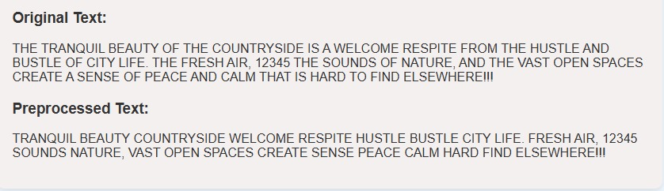
REMOVE STOPWORDS

Slide 16
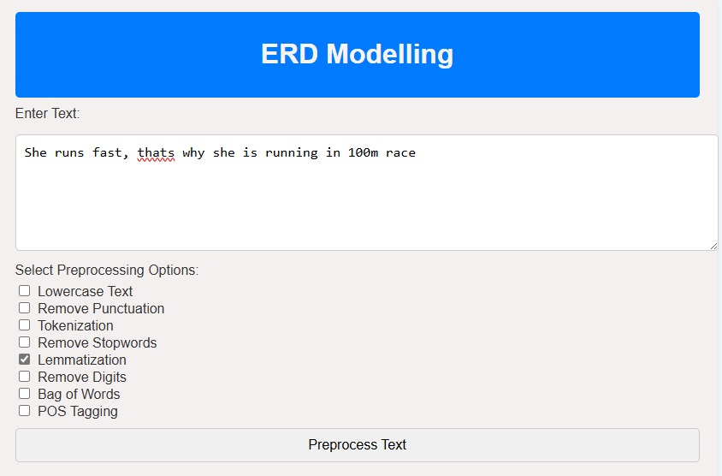
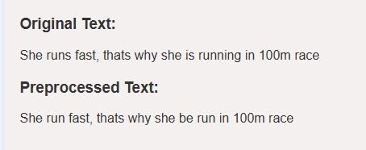
LEMMATIZATION

Slide 17
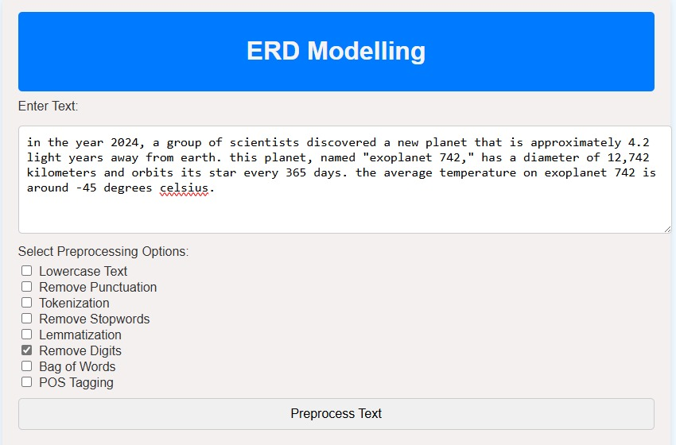
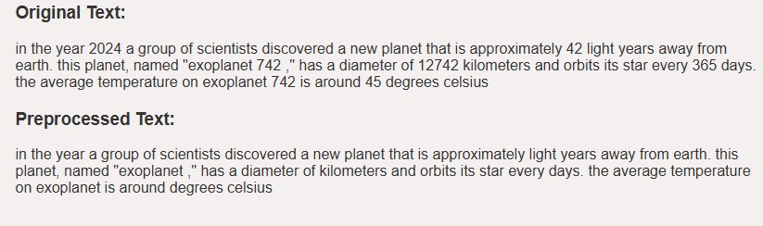
REMOVE DIGITS

Slide 18
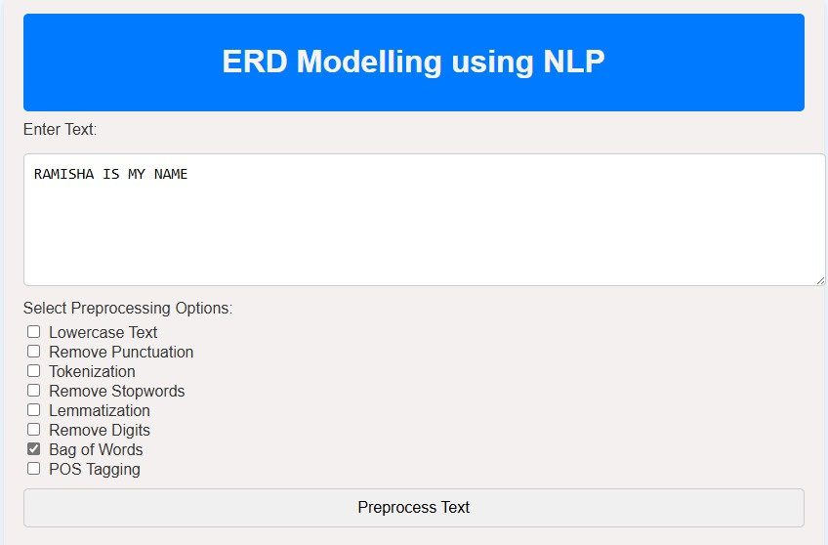
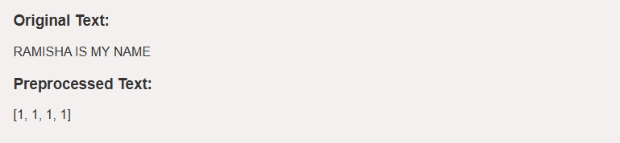
BAG OF WORDS

Slide 19
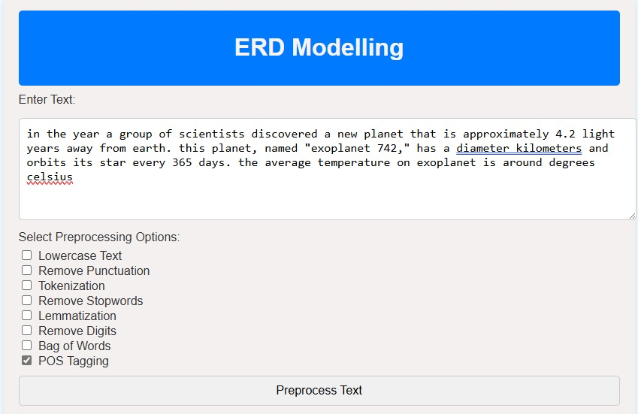
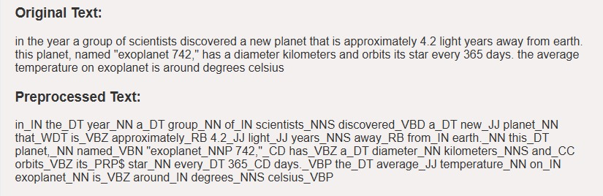
POS TAGGING

Slide 20
OBJECTIVES
User-Friendly Interface: Ease of use, Interactive Components, Real-time Updates.
Text Input Handling: Keyword Detection, Data Cleaning.
Entity and Relationship Identification: Entity Recognition, Attribute Extraction, Relationship Detection.
ERD Generation: Automatic Diagram Generation, Entity Representation, Relationship Representation.
Text-Based Input Area: Provide a section where users can input raw text or descriptions (e.g., requirements or schema) and see the system extract relevant data for ERD creation

Slide 21
APPLICATIONS
Information Extraction: ERD modeling helps identify entities, attributes, and relationships in unstructured text data, enabling information extraction for various applications.
Knowledge Graph Construction: ERD modeling is used to design knowledge grapTopichs, which represent entities, relationships, and concepts extracted from text data, facilitating question answering, recommendation systems, and more.
Sentiment Analysis: ERD modeling can be used to identify entities, relationships, and concepts associated with sentiment-bearing phrases, enabling more accurate sentiment analysis and opinion mining.
Question Answering: ERD modeling facilitates the creation of question answering systems by identifying entities, relationships, and concepts in text data, enabling the retrieval of relevant answers.
Modeling: ERD modeling can be used to identify relationships between topics, entities, and concepts in text data, enabling the creation of more accurate topic models and facilitating text classification, clustering, and more.

Slide 22
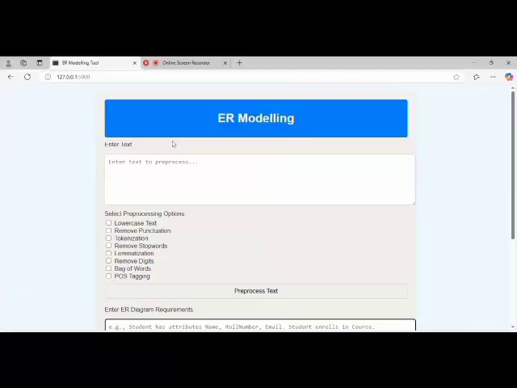
Downloads ER diagram

Slide 23
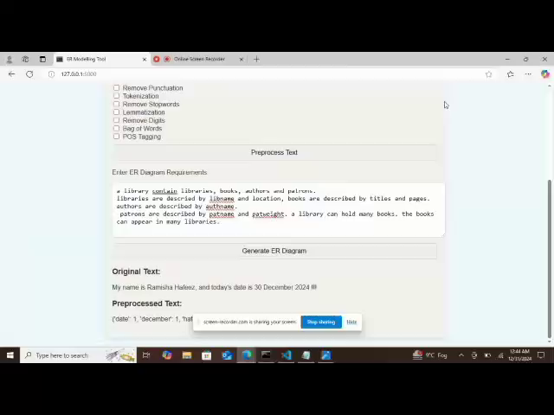
ER diagram created

Slide 24
Thanks

